Slide 1
Product Recommendation System
Harianth Kumar Kancharla
Likhitha Gupta Thallapally
Pavani Billapati
Trilok Kumar Pidikiti

Slide 2

Vision Statement
Building recommendation system for products on an e-commerce website like Amazon, Flipkart and many more.

Slide 3
Approach..
Predicting the products, based ratings a user might have given to a specific item.
These ratings will then be ranked and are used to predict the most suitable products.

Slide 4

Recommendation systems
Is an artificial intelligence algorithm, usually associated with machine learning, that uses Big Data to suggest or recommend additional products to consumers.

Slide 5
Description
Websites like Amazon, Flipkart uses different recommendation models to provide different suggestions to different users.
Recommendation Systems
Content Based Filtering
Recommendation Systems
Hybrid Filtering
Collaborative Filtering

Slide 6
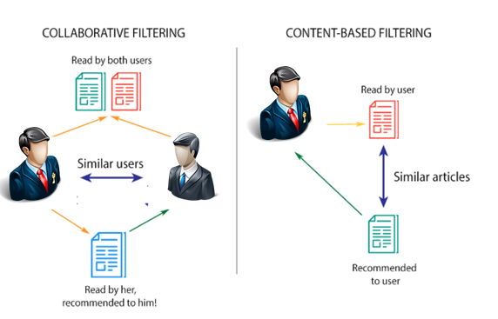
Content-based filtering uses item features to recommend other items similar to what the user likes, based on their previous actions or explicit feedback.
Rated by user
Similar Products
Recommend product

Slide 7
In this project we have adopted collaborative filtering.
Collaborative filtering scales to massive datasets and produces high quality recommendation in real time.
This project is influenced by amazon’s recommendation system.
Rated by Similar Users
Rated by Similar Users
User 1
Purchased by User 1, recommended to similar users
Product Recommendations

Slide 8
Collaborative Filtering
Memory Based
Model Based
Uses user rating historical data to compute the similarity between users or items.
Uses machine learning algorithms to predict users’ rating of unrated items.

Slide 9
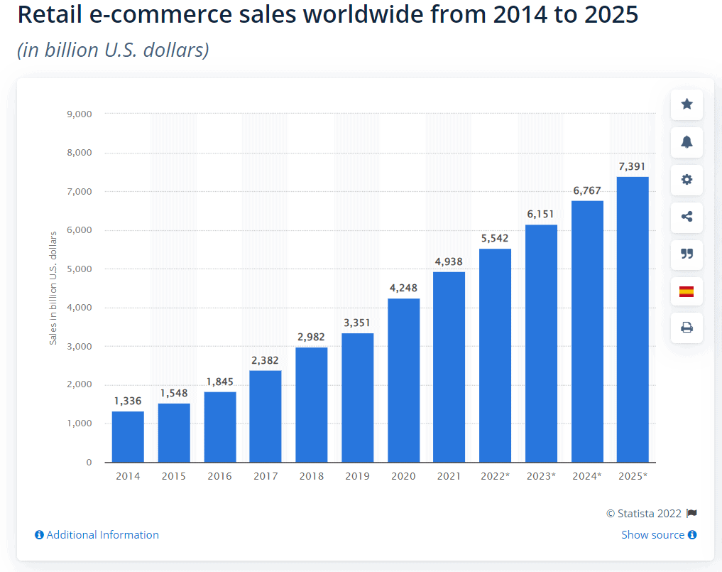
Statistics

Slide 10
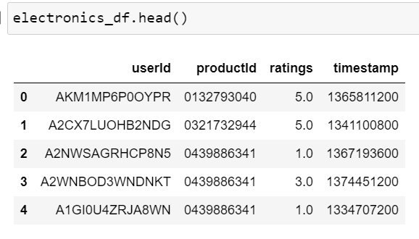
Data Set
Source – Amazon Dataset Page
It contains 4 Features with around 80 million rows.

Slide 11
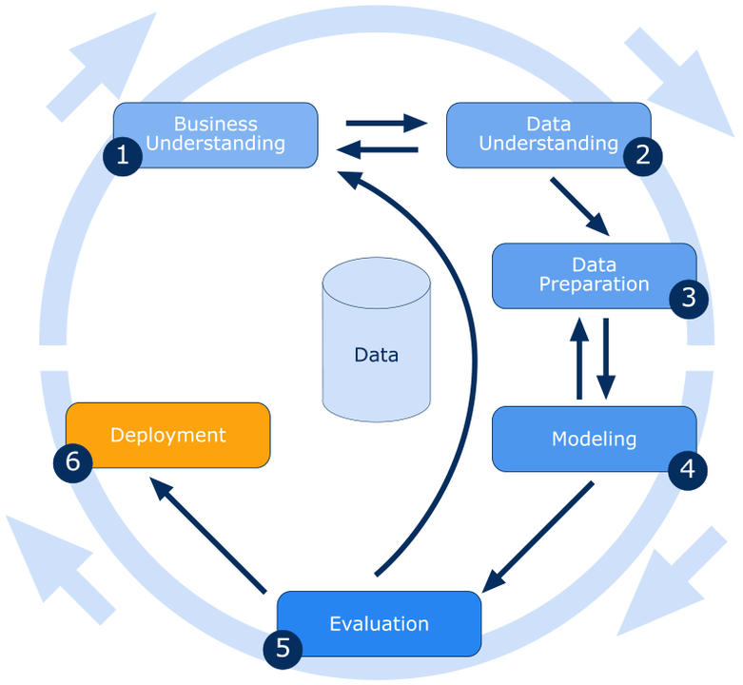
Methodology

Slide 12
Thank You

